Slide 1
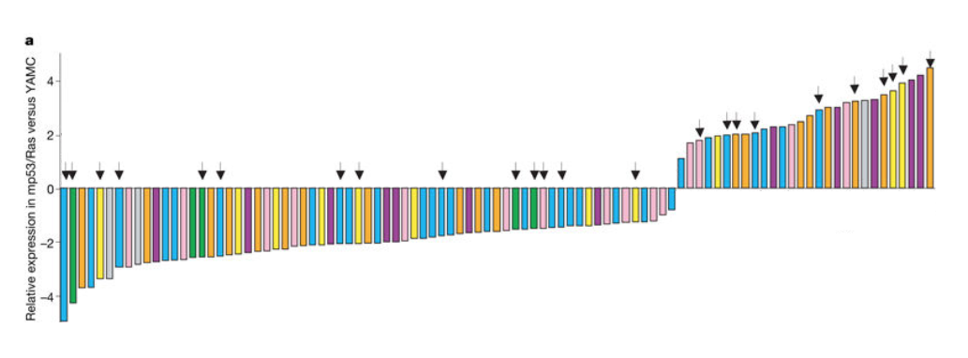


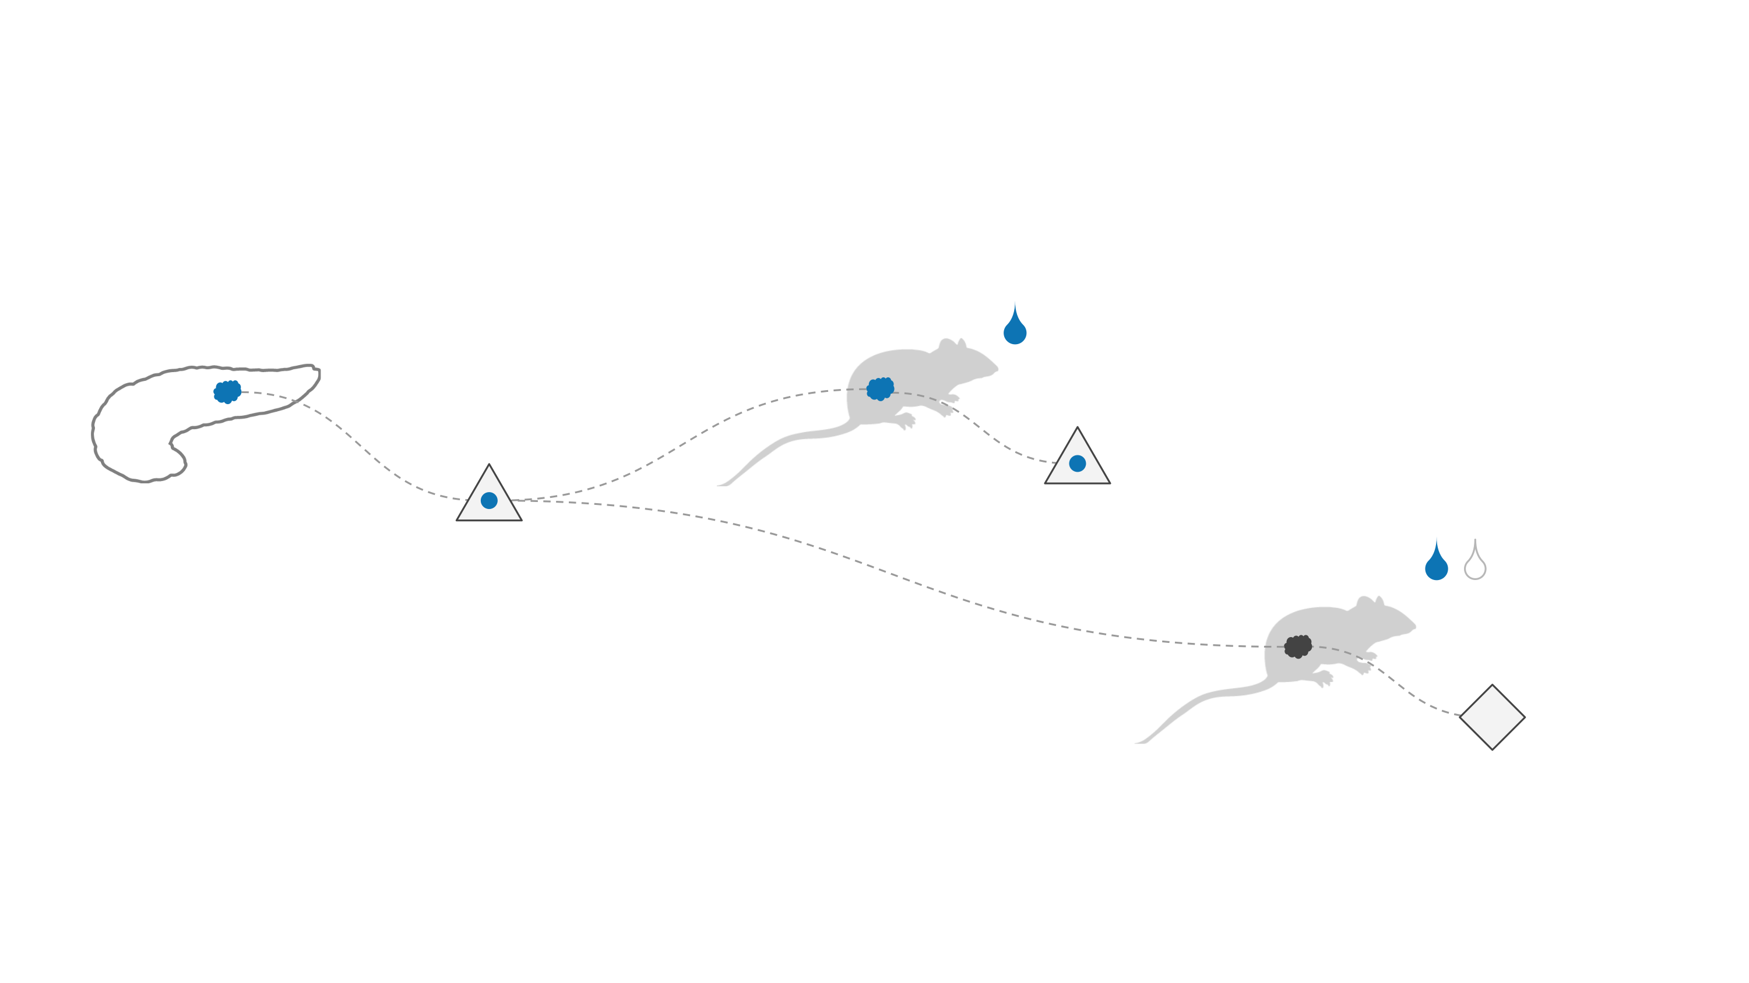
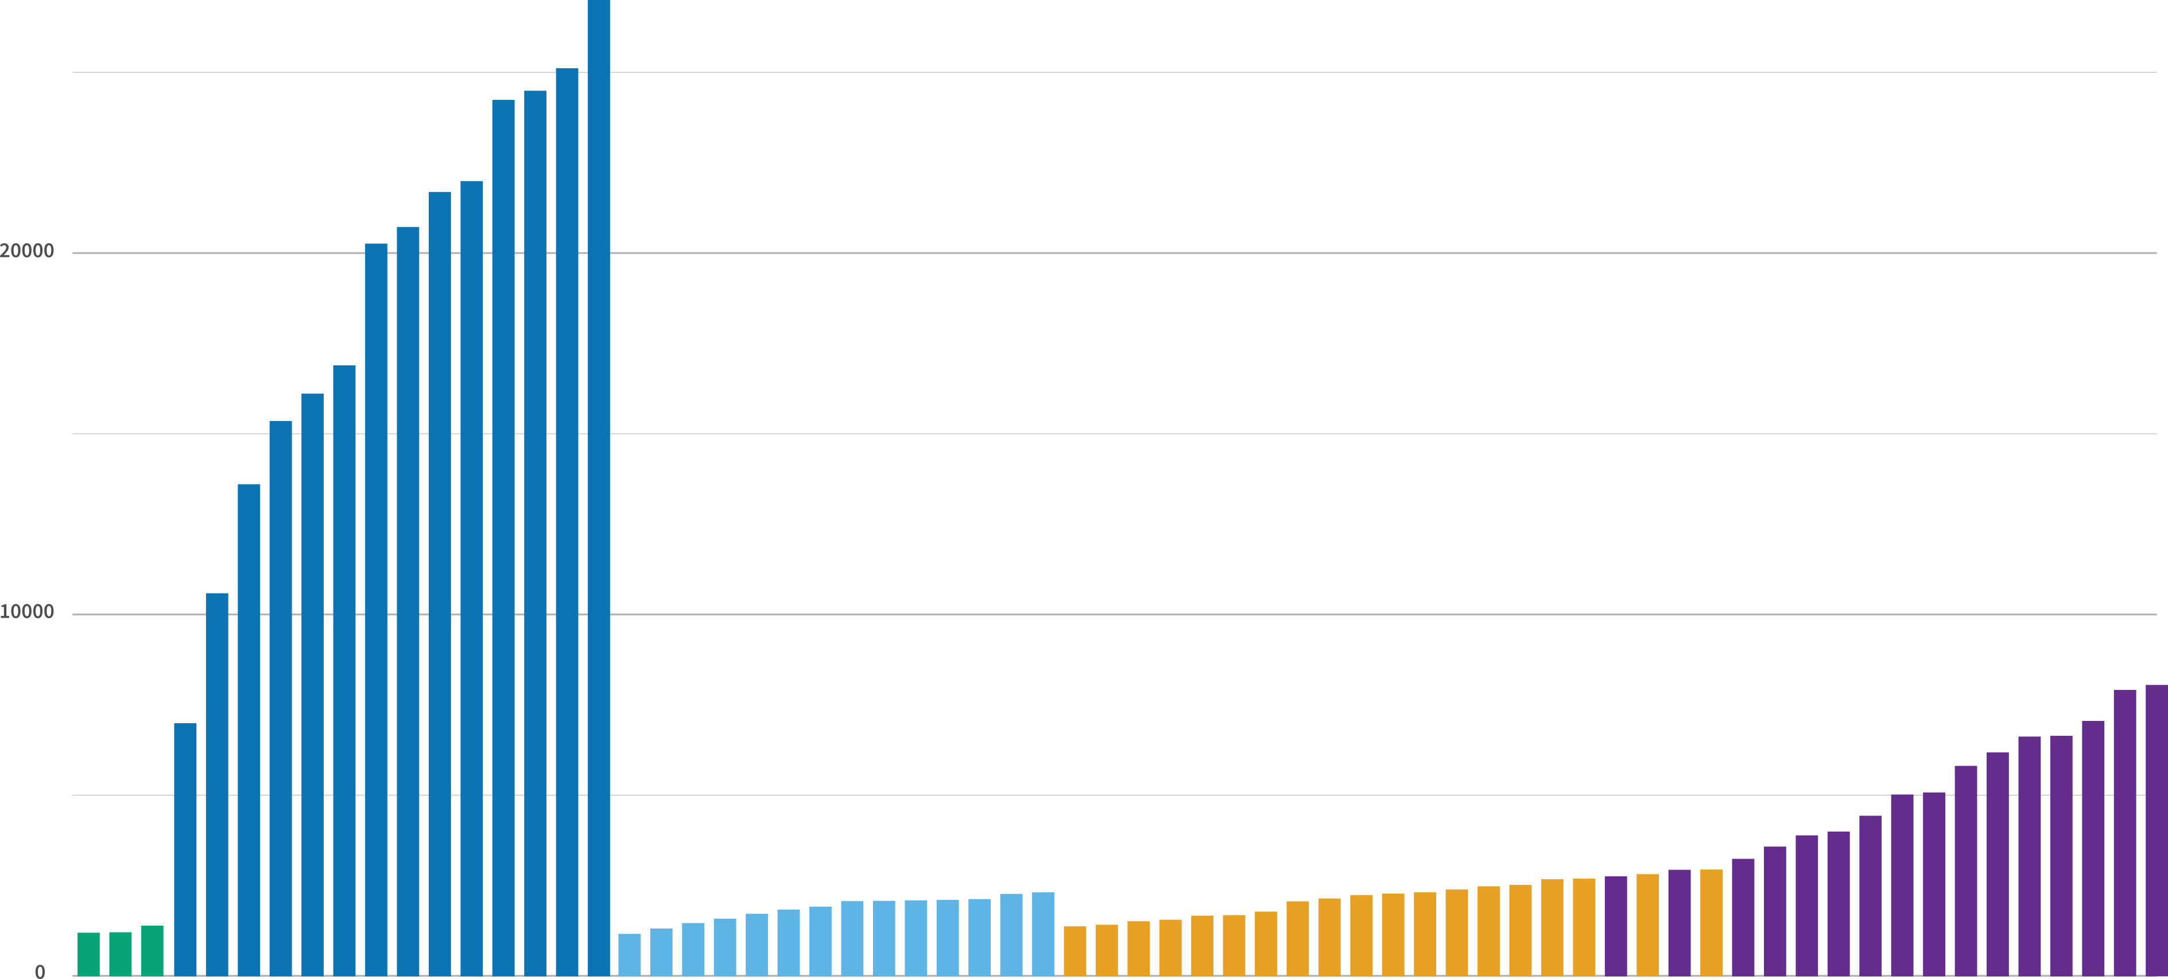
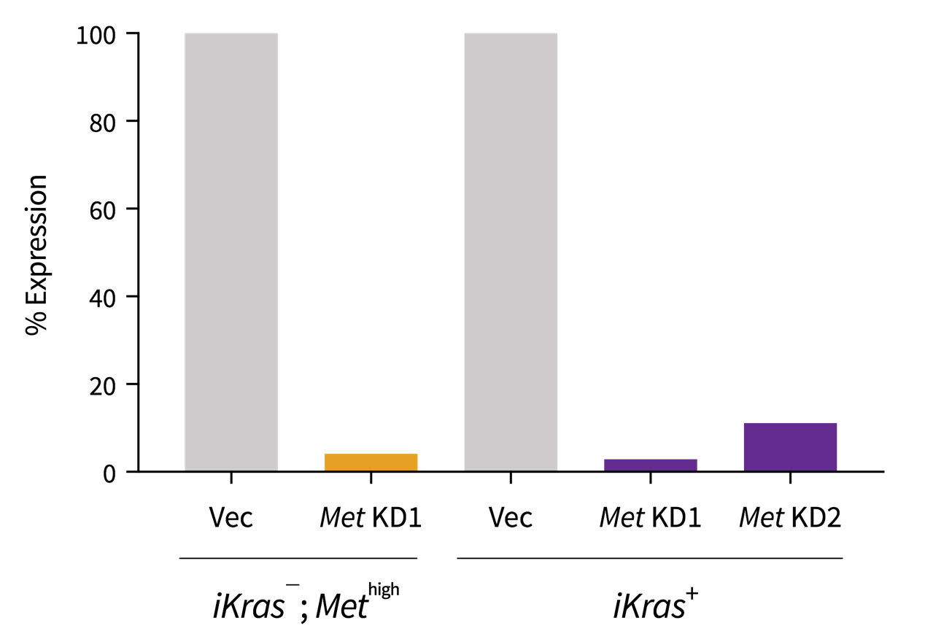
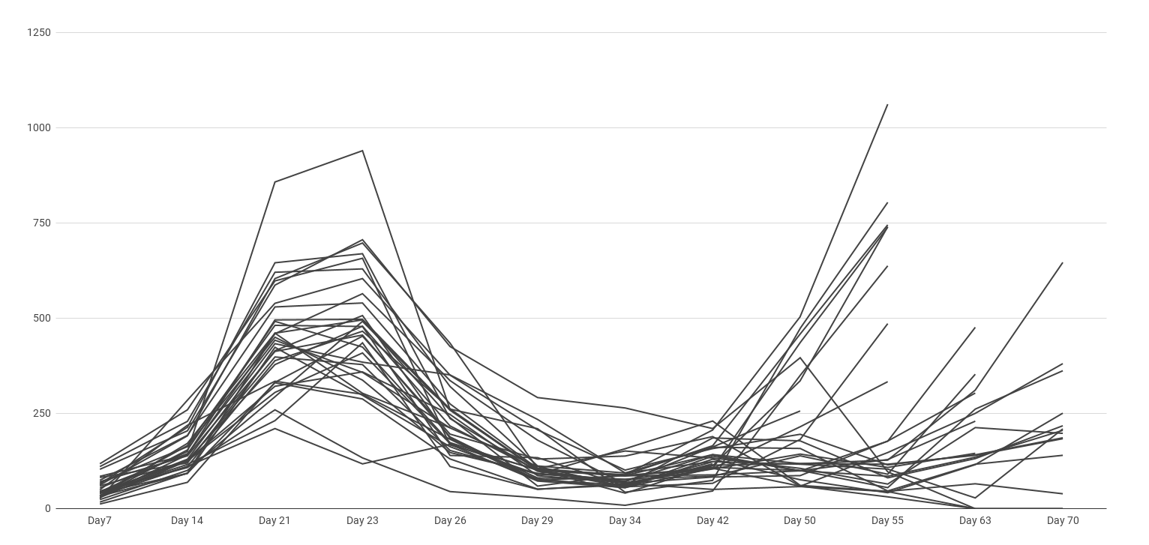
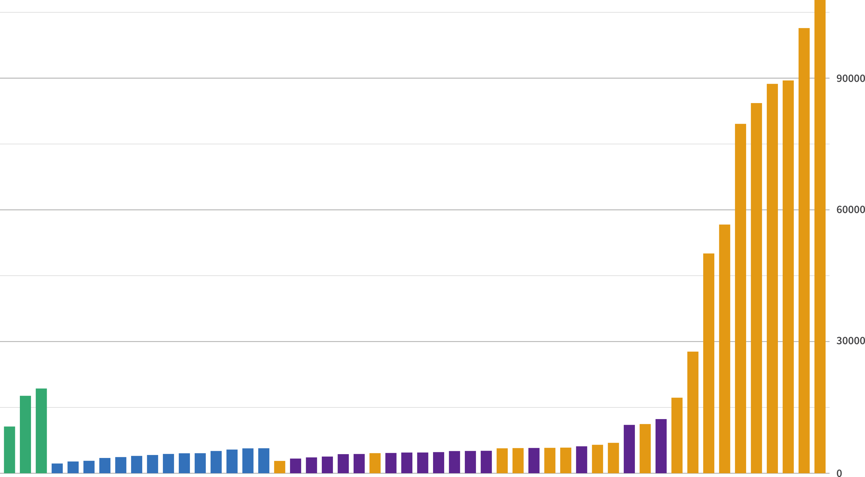
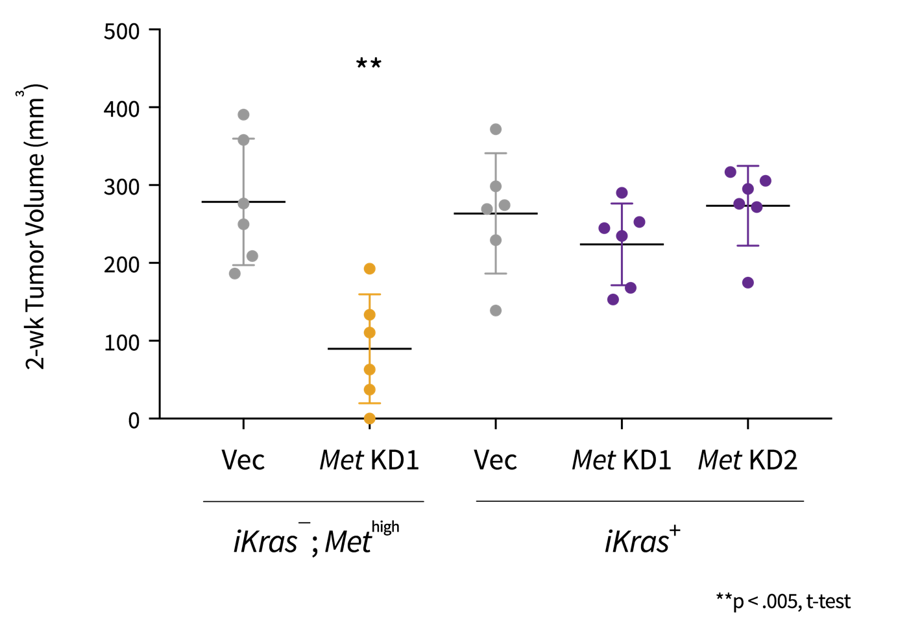
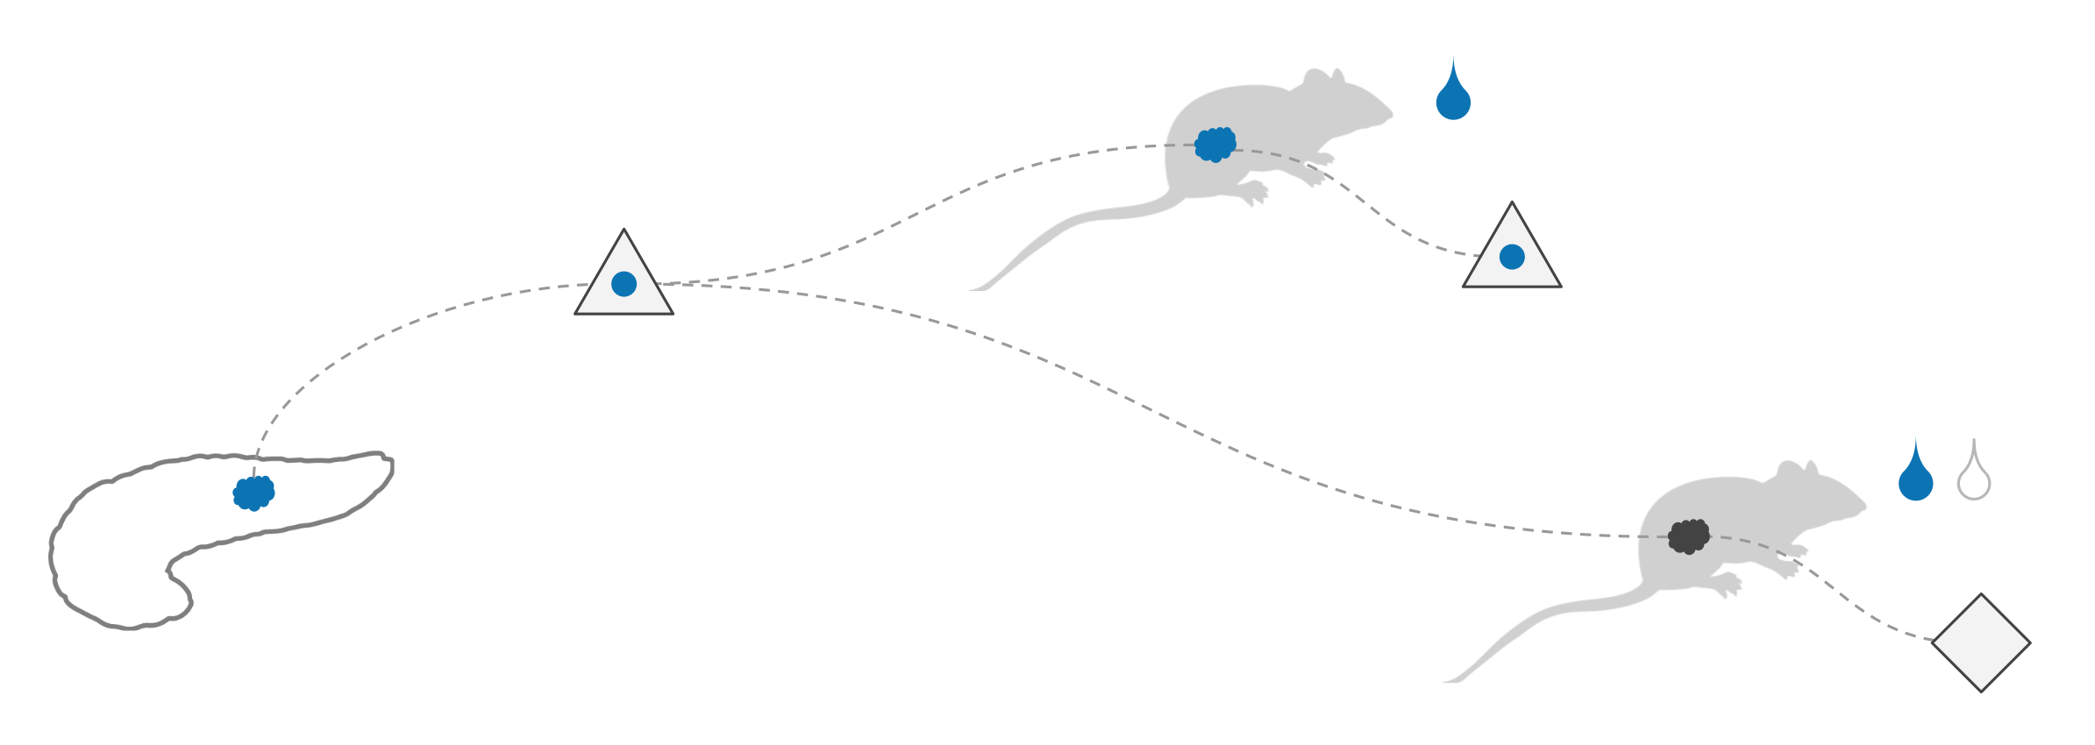
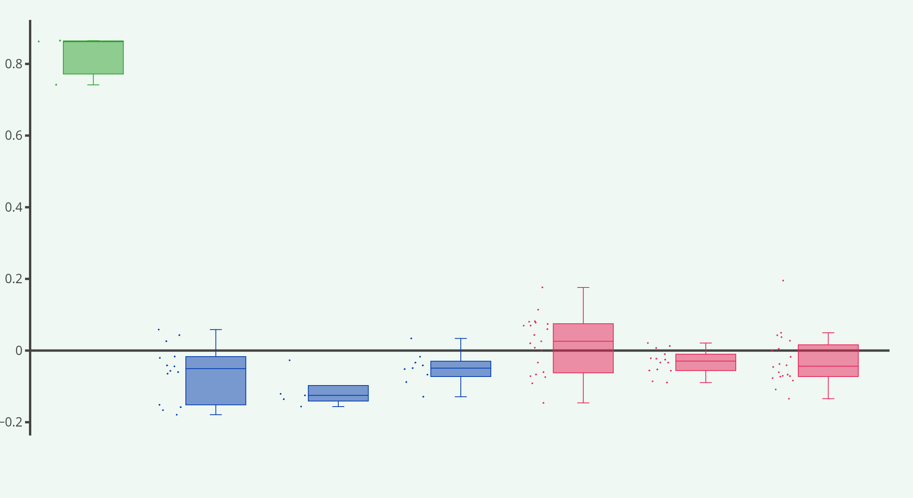
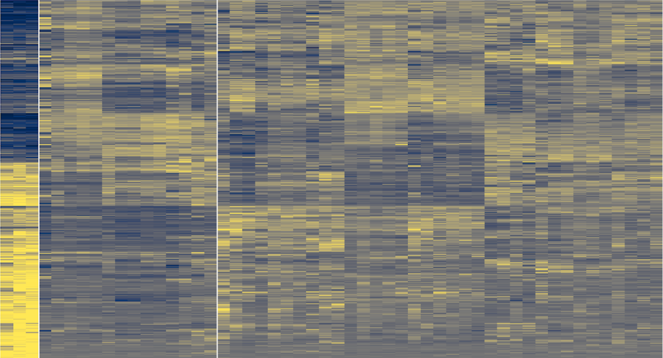
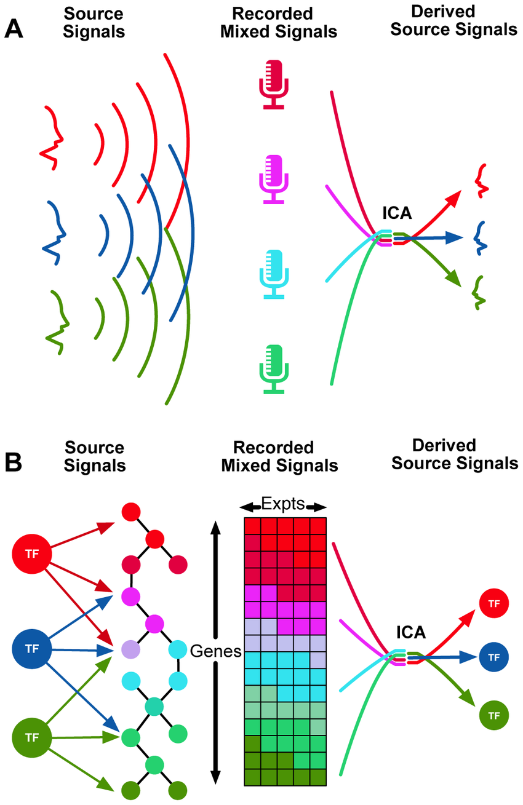
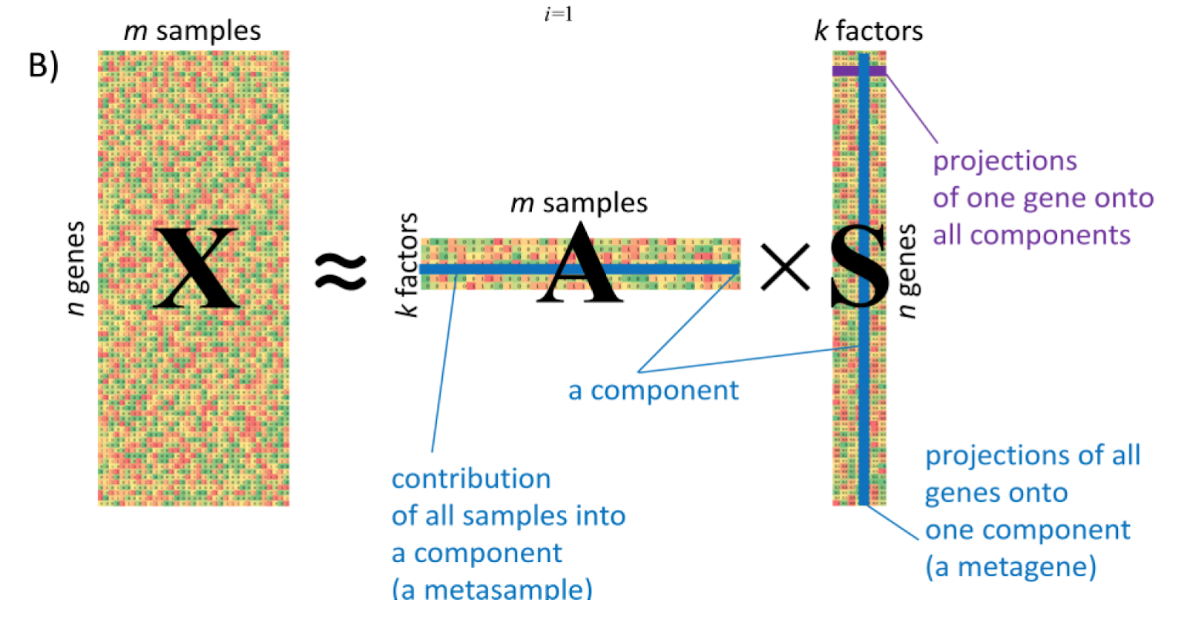
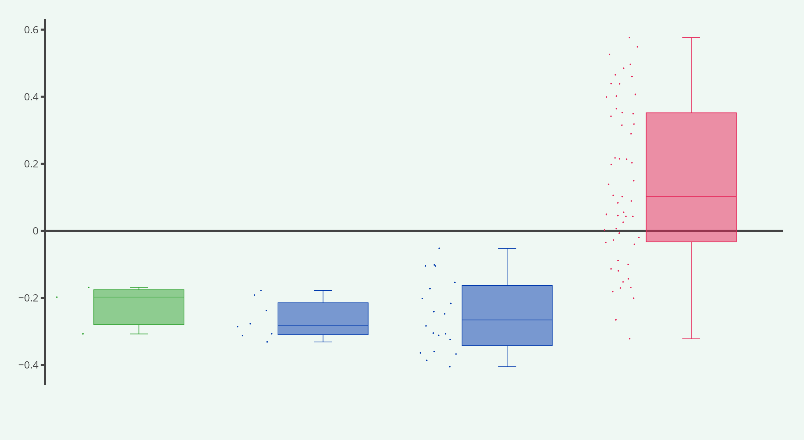
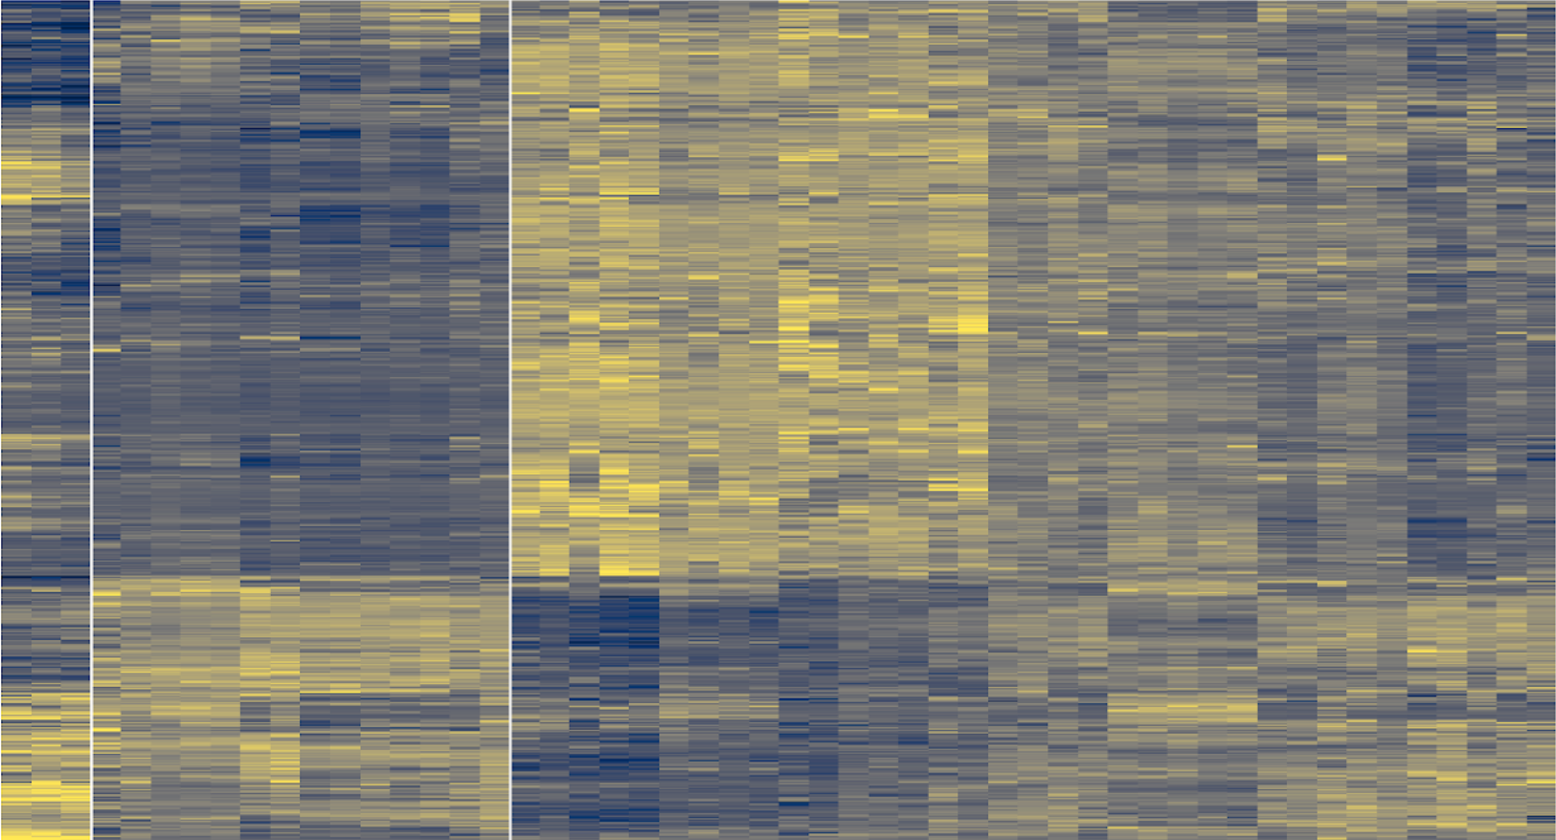
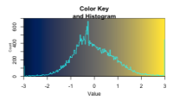
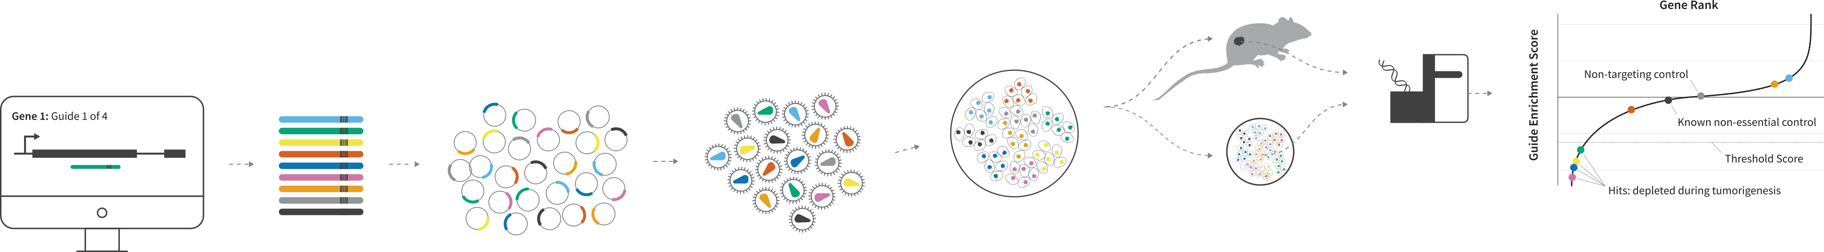
Common patterns of transcriptional dysregulation underlie primary and recurrent tumorigenesis
Highlights
Tumor recurrence is a common response to treatment and many recurrent cells emerge with novel oncogenic drivers and therapeutic resistance.
Transcriptomic analysis of primary and recurrent tumor cells reveals shared, driver-independent gene expression patterns
A pooled CRISPR dropout screen can reveal shared survival mechanisms in primary and recurrent tumors and may point to shared therapeutic vulnerabilities
Methods
A dox-inducible, pancreatic-specific mutant Kras transgene to model PDAC progression and recurrence
Bulk RNA-Seq of primary and recurrent tumor cell lines
Dimension reduction and module detection via Independent Component Analysis in R
An in-vivo, pooled, CRISPR-based competition assay to test the functional contribution of select genes to primary and recurrent tumor cell survival
Background
After identifying a group of genes synergistically dysregulated downstream of cooperating oncogenic mutations, McMurray et al. showed that many genes were critical to maintain tumorigenesis. These cooperation response genes (CRGs, shown at right) experience dysregulated expression after malignant transformation and their wild type protein products play roles in supporting a wide array of hallmark properties. Notably, the reversal of dysregulated CRG expression can restrict tumor growth in multiple murine cancer models.
Derek Crowe, Jordan Aldersley, Katherine Singleton,
Aslihan Ambeskovic, Hartmut Land
Department of Biomedical Genetics, University of Rochester
Arrows indicate CRGs critical for tumor growth
Correspondence: derek_crowe@urmc.rochester.edu
Primary PDAC development and tumor recurrence can be modeled using a doxycycline-inducible Kras^{G12D} transgene
Some tumors recur independent of Kras^{G12D} transgene expression
shRNA reduces Met transcript levels
in tumor recurrences
Kras^{G12D}
expressed
Kras^{G12D}
inactive
Kras Transcript Counts (rlog²)
Tumor Volume (mm³)
Normal
Primary + dox
Primary - dox
Recurrence iKras –
Recurrence iKras +
Many Kras-independent recurrences have elevated Met expression
Kras-independent, high-Met recurrences are dependent on Met for tumor growth
Primary and recurrent PDAC cell lines were established
and RNA sequenced
p48-Cre^{+/-} ; ROSA_rTta^{+/+};
p53^{WT/fl} ; tet-LSL-Kras^{G12D}
dox+ primary tumor cell lines
Met Transcript Counts (rlog²)
dox- recurrent tumor cell lines
Normal
Primary + dox
Recurrence iKras +
Recurrence iKras –
Independent Component Analysis (ICA) identifies genes with common transcriptional behavior across different tumor classes
Component 4 sample weights are agnostic to transformed phenotype
Component 4 gene behavior is largely
agnostic to transformed phenotype
ICA is a matrix decomposition technique that reduces the dimensionality of our transcriptomic dataset by defining two new matrices which, when multiplied, approximate the original data. These matrices capture the cumulative effects of unknown biological and technical processes. The number of these processes, or components, is predetermined from the original data structure.
Each gene and each sample is given a separate weight for its unique contribution to a component. By correlating these weights with known phenotypic information, such as tumor status, we can identify components of interest. We can then select the genes that contribute significantly to these components, which may also contribute to the biology underlying our phenotypes of interest.
Expression of IC4 Genes
IC4 Sample Weights
Normal
Primary tumors
Recurrent tumors
Norm
Primary
Recurrent tumors
Component 3 sample weights are specific to the recurrent phenotype
Component 3 gene behavior is specific to some recurrent tumors
IC3 Sample Weights
Expression of IC3 Genes
Normal
Primary tumors
Recurrent
tumors
Norm
Primary
Recurrent tumors
A pooled CRISPR dropout screen can reveal common functional
dependencies and may point to shared therapeutic vulnerabilities
4 guides targeting each gene are designed, barcoded, and ordered
Guides are cloned into plasmids and packaged into lentiviral particles
Transduced cells are injected into immunocompromised mice
while control cells are passaged in vitro.
DNA is acquired at multiple timepoints and submitted for NGS. Statistical analysis reveals putative hits, which must be validated.

Slide 2



Bending neural waves: Characterising tACS Effects on Working Memory Performance
Highlights
Tumor recurrence is a common response to treatment and many recurrent cells emerge with novel oncogenic drivers and therapeutic resistance.
Transcriptomic analysis of primary and recurrent tumor cells reveals shared, driver-independent gene expression patterns
A pooled CRISPR dropout screen can reveal shared survival mechanisms in primary and recurrent tumors and may point to shared therapeutic vulnerabilities
Methods
A dox-inducible, pancreatic-specific mutant Kras transgene to model PDAC progression and recurrence
Bulk RNA-Seq of primary and recurrent tumor cell lines
Dimension reduction and module detection via Independent Component Analysis in R
An in-vivo, pooled, CRISPR-based competition assay to test the functional contribution of select genes to primary and recurrent tumor cell survival
Rahul Venugopal¹, Arun Sasidharan¹, Ramajayam G¹, Ravindra PN¹, Nithin Nagaraj², Kaviraj Udupa³, John P John⁴, Bindu M Kutty¹
Background
After identifying a group of genes synergistically dysregulated downstream of cooperating oncogenic mutations, McMurray et al. showed that many genes were critical to maintain tumorigenesis. These cooperation response genes (CRGs, shown at right) experience dysregulated expression after malignant transformation and their wild type protein products play roles in supporting a wide array of hallmark properties. Notably, the reversal of dysregulated CRG expression can restrict tumor growth in multiple murine cancer models.
Department of Biomedical Genetics, University of Rochester
Arrows indicate CRGs critical for tumor growth
Correspondence: rahul.nimhans@gmail.com
Primary PDAC development and tumor recurrence can be modeled using a doxycycline-inducible Kras^{G12D} transgene
Some tumors recur independent of Kras^{G12D} transgene expression
shRNA reduces Met transcript levels
in tumor recurrences
Kras^{G12D}
expressed
Kras^{G12D}
inactive
Kras Transcript Counts (rlog²)
Tumor Volume (mm³)
Normal
Primary + dox
Primary - dox
Recurrence iKras –
Recurrence iKras +
Many Kras-independent recurrences have elevated Met expression
Kras-independent, high-Met recurrences are dependent on Met for tumor growth
Primary and recurrent PDAC cell lines were established
and RNA sequenced
p48-Cre^{+/-} ; ROSA_rTta^{+/+};
p53^{WT/fl} ; tet-LSL-Kras^{G12D}
dox+ primary tumor cell lines
Met Transcript Counts (rlog²)
dox- recurrent tumor cell lines
Normal
Primary + dox
Recurrence iKras +
Recurrence iKras –
Independent Component Analysis (ICA) identifies genes with common transcriptional behavior across different tumor classes
Component 4 sample weights are agnostic to transformed phenotype
Component 4 gene behavior is largely
agnostic to transformed phenotype
ICA is a matrix decomposition technique that reduces the dimensionality of our transcriptomic dataset by defining two new matrices which, when multiplied, approximate the original data. These matrices capture the cumulative effects of unknown biological and technical processes. The number of these processes, or components, is predetermined from the original data structure.
Each gene and each sample is given a separate weight for its unique contribution to a component. By correlating these weights with known phenotypic information, such as tumor status, we can identify components of interest. We can then select the genes that contribute significantly to these components, which may also contribute to the biology underlying our phenotypes of interest.
Expression of IC4 Genes
IC4 Sample Weights
Normal
Primary tumors
Recurrent tumors
Norm
Primary
Recurrent tumors
Component 3 sample weights are specific to the recurrent phenotype
Component 3 gene behavior is specific to some recurrent tumors
IC3 Sample Weights
Expression of IC3 Genes
Normal
Primary tumors
Recurrent
tumors
Norm
Primary
Recurrent tumors
A pooled CRISPR dropout screen can reveal common functional
dependencies and may point to shared therapeutic vulnerabilities
4 guides targeting each gene are designed, barcoded, and ordered
Guides are cloned into plasmids and packaged into lentiviral particles
Transduced cells are injected into immunocompromised mice
while control cells are passaged in vitro.
DNA is acquired at multiple timepoints and submitted for NGS. Statistical analysis reveals putative hits, which must be validated.

